Slide 1
Electronics of Radio
Notes on David Rutledge’s book
John Manferdelli
johnmanferdelli@hotmail.com

Slide 2
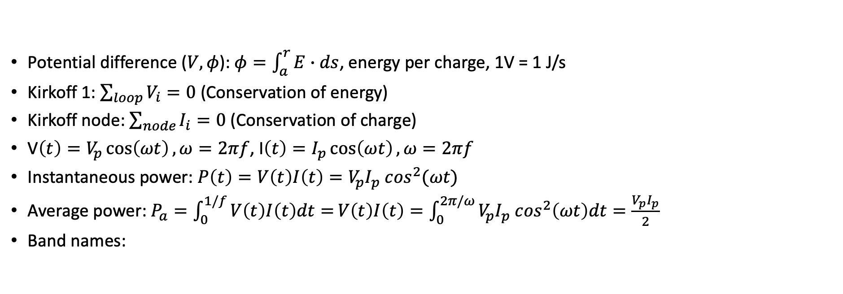
Basic concepts
Potential difference ($V, φ$): $φ=\int_{a}^{r}{E∙ds}$, energy per charge, 1V = 1 J/s
Kirkoff 1: $\sum_{loop}{V_{i}=0}$ (Conservation of energy)
Kirkoff node: $\sum_{node}{I_{i}=0}$ (Conservation of charge)
V$\left(t\right)=V_{p}\cos\left(ωt\right), ω=2πf$, I$\left(t\right)=I_{p}\cos\left(ωt\right), ω=2πf$
Instantaneous power: $P\left(t\right)=V\left(t\right)I\left(t\right)=V_{p}I_{p} \cos^{2}(ωt)$
Average power: $P_{a}=\int_{0}^{1/f}{V\left(t\right)I\left(t\right)dt=}V\left(t\right)I\left(t\right)=\int_{0}^{2π/ω}{V_{p}I_{p} \cos^{2}\left(ωt\right)dt}=\frac{V_{p}I_{p}}{2}$
Band names:
Name | Frequency
VLF | 3-30kHz
LW | 20-300kHz
MW | 300kHz-3MHz
HF | 3MHz-30MHz
VHF | 30-300MHz
Name | Frequency
UHF | 300MHz-1GHz
uW | 1-30GHz
milliW | 30-300GHz
submilliF | >300GHz

Slide 3

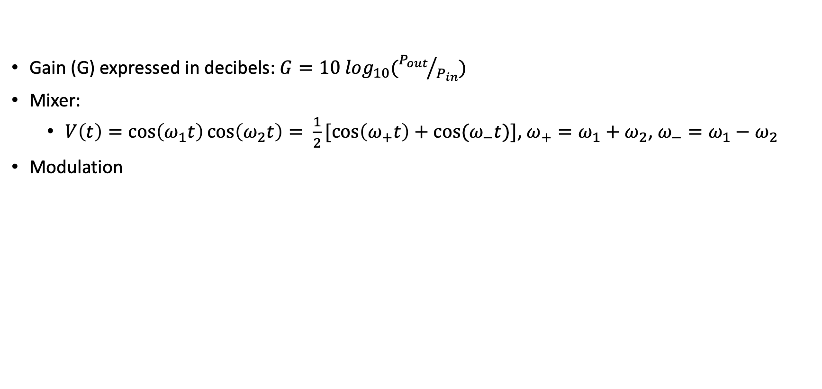
Signals
Gain (G) expressed in decibels: $G=10 \log_{10}({P_{out}}/{P_{in}})$
Mixer:
$V\left(t\right)=\cos\left(ω_{1}t\right)\cos\left(ω_{2}t\right)= \frac{1}{2}[\cos\left(ω_{+}t\right)+cos⁡(ω_{−}t)]$, $ω_{+}=ω_{1}+ω_{2}$, $ω_{−}=ω_{1}−ω_{2}$
Modulation
Name | Equation
AM | $$V\left(t\right)=a\left(t\right)cos⁡(ω_{c}t)$$
FM | $$V\left(t\right)=V_{c}cos⁡({(ω}_{c}+a\left(t\right))t)$$
FSK | $V\left(t\right)=V_{c}cos⁡(ω_{1}t)$, if 1 $V\left(t\right)=V_{c}cos⁡(ω_{0}t)$, if 0
PSK | $V\left(t\right)={+V}_{p}cos⁡(ωt)$, if 1 $V\left(t\right)=−V_{p}cos⁡(ωt)$, if 0

Slide 4



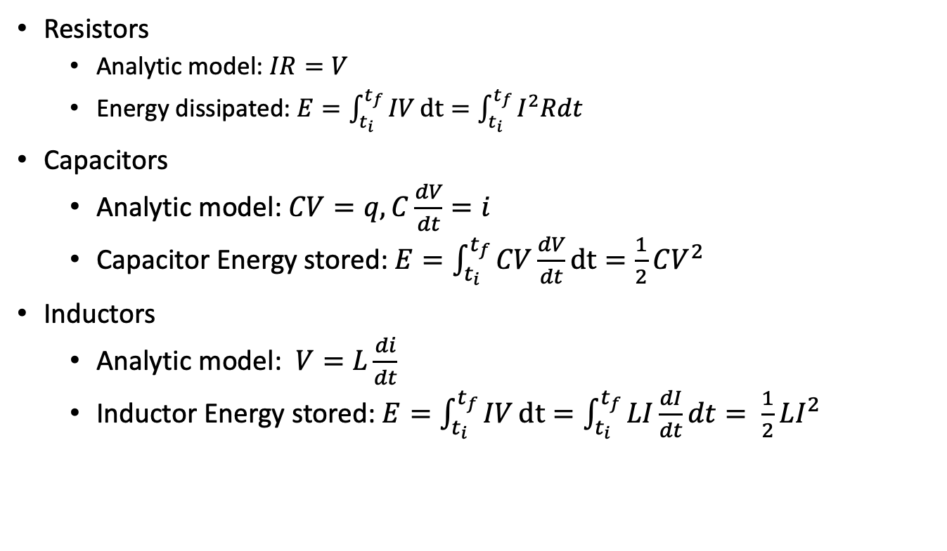
Resistors, capacitors, inductors
Resistors
Analytic model: $IR=V$
Energy dissipated: $E=\int_{t_{i}}^{t_{f}}{IV}dt=\int_{t_{i}}^{t_{f}}{I^{2}Rdt}$
Capacitors
Analytic model: $CV=q, C\frac{dV}{dt}=i$
Capacitor Energy stored: $E=\int_{t_{i}}^{t_{f}}{CV\frac{dV}{dt}}dt=\frac{1}{2}CV^{2}$
Inductors
Analytic model: $V=L\frac{di}{dt}$
Inductor Energy stored: $E=\int_{t_{i}}^{t_{f}}{IV}dt=\int_{t_{i}}^{t_{f}}{LI\frac{dI}{dt}dt= \frac{1}{2}LI^{2}}$
R
Credit: Make Electronics

Slide 5

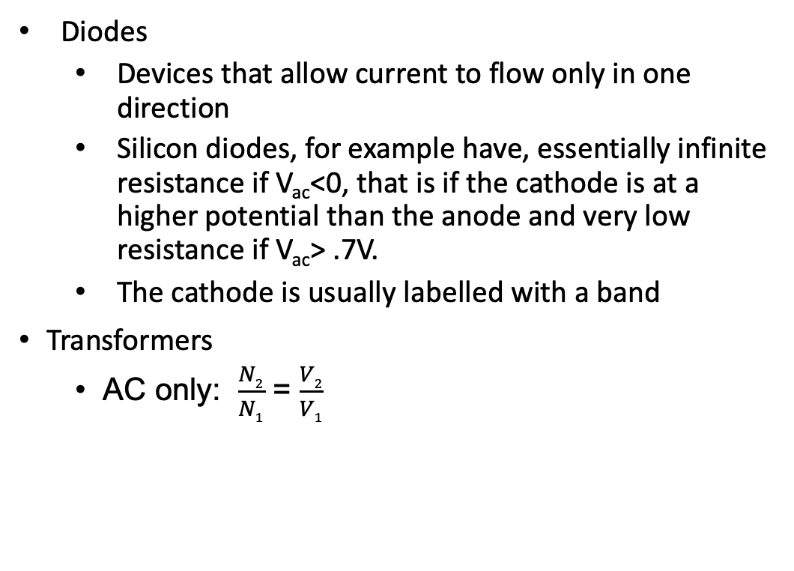
Diodes, transformers
Diodes
Devices that allow current to flow only in one direction
Silicon diodes, for example have, essentially infinite resistance if V_{ac}<0, that is if the cathode is at a higher potential than the anode and very low resistance if V_{ac}> .7V.
The cathode is usually labelled with a band
Transformers
AC only: $\frac{N2}{N1}$ = $\frac{V2}{V1}$
Credit: Make Electronics

Slide 6
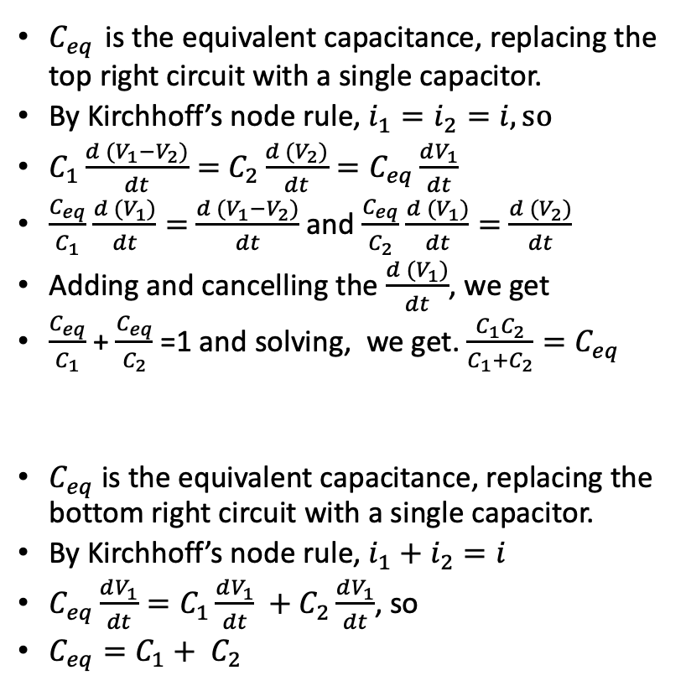
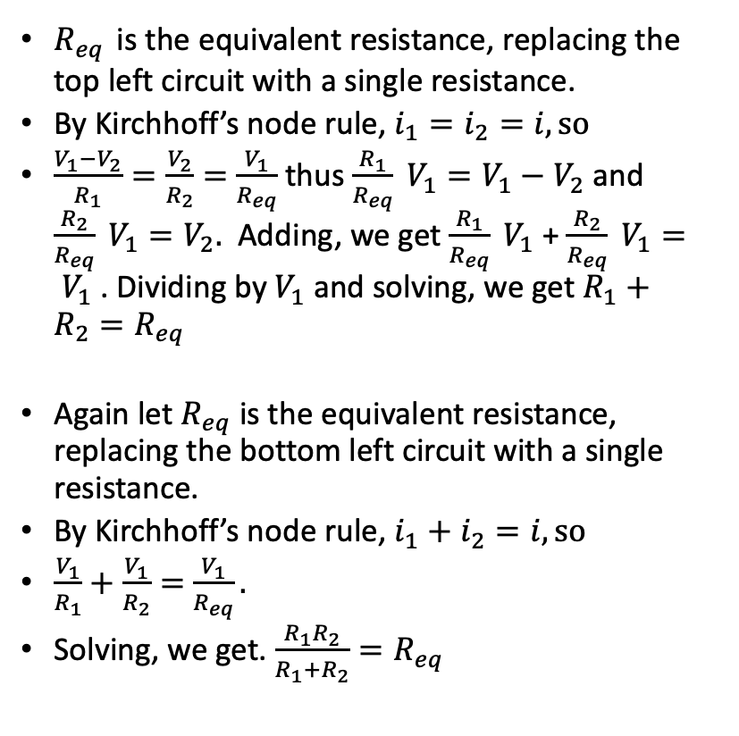
Simple circuit analysis with Kirchhoff
$R_{eq}$ is the equivalent resistance, replacing the top left circuit with a single resistance.
By Kirchhoff’s node rule, $i_{1}=i_{2}=i, so$
$\frac{V_{1}−V_{2}}{R_{1}}=\frac{V_{2}}{R_{2}}=$ $\frac{V_{1}}{R_{eq}}$ thus $\frac{R_{1}}{R_{eq}} V_{1}=V_{1}−V_{2}$ and $\frac{R_{2}}{R_{eq}} V_{1}=V_{2}.$ Adding, we get $\frac{R_{1}}{R_{eq}} V_{1}$ + $\frac{R_{2}}{R_{eq}} V_{1}= V_{1}$ . Dividing by $V_{1}$ and solving, we get $R_{1}+R_{2}=R_{eq}$
Again let $R_{eq}$ is the equivalent resistance, replacing the bottom left circuit with a single resistance.
By Kirchhoff’s node rule, $i_{1}+i_{2}=i, so$
$\frac{V_{1}}{R_{1}}+\frac{V_{1}}{R_{2}}=$ $\frac{V_{1}}{R_{eq}}.$
Solving, we get. $\frac{R_{1}R_{2}}{R_{1}+R_{2}}=R_{eq}$
$C_{eq}$ is the equivalent capacitance, replacing the top right circuit with a single capacitor.
By Kirchhoff’s node rule, $i_{1}=i_{2}=i, so$
$C_{1}\frac{d (V_{1}−V_{2})}{dt}=$ $C_{2}\frac{d (V_{2})}{dt}=C_{eq}\frac{dV_{1}}{dt}$
$\frac{C_{eq}}{C_{1}}$ $\frac{d (V_{1})}{dt}=$ $\frac{d (V_{1}−V_{2})}{dt}$ and $\frac{C_{eq}}{C_{2}}$ $\frac{d (V_{1})}{dt}=$ $\frac{d (V_{2})}{dt}$
Adding and cancelling the $\frac{d (V_{1})}{dt}$, we get
$\frac{C_{eq}}{C_{1}}$ + $\frac{C_{eq}}{C_{2}}$ =1 and solving, we get. $\frac{C_{1}C_{2}}{C_{1}+C_{2}}=C_{eq}$
$C_{eq}$ is the equivalent capacitance, replacing the bottom right circuit with a single capacitor.
By Kirchhoff’s node rule, $i_{1}+i_{2}=i$
$C_{eq}\frac{dV_{1}}{dt}=C_{1}\frac{dV_{1}}{dt} +C_{2}\frac{dV_{1}}{dt}$, so
$C_{eq}=C_{1}+ C_{2}$
V₁
V₁
R₁
i₁
C₁
i₁
i
i
V₂
V₂
R₂
i₂
C₂
i₂
V=0
V=0
V₁
i
R₁
i₁
V₁
R₂
i₂
i
C₁
i₁
C₂
i₂
V=0
V=0

Slide 7
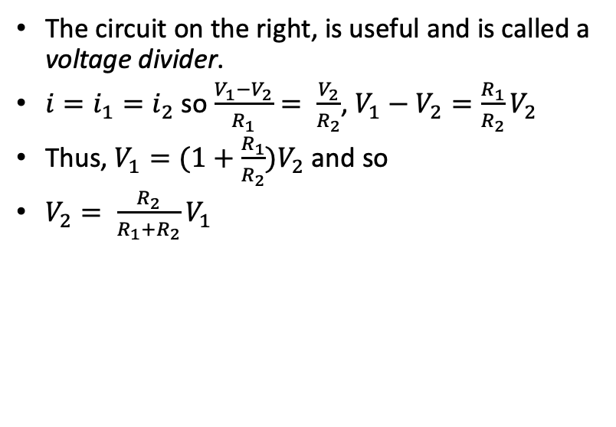
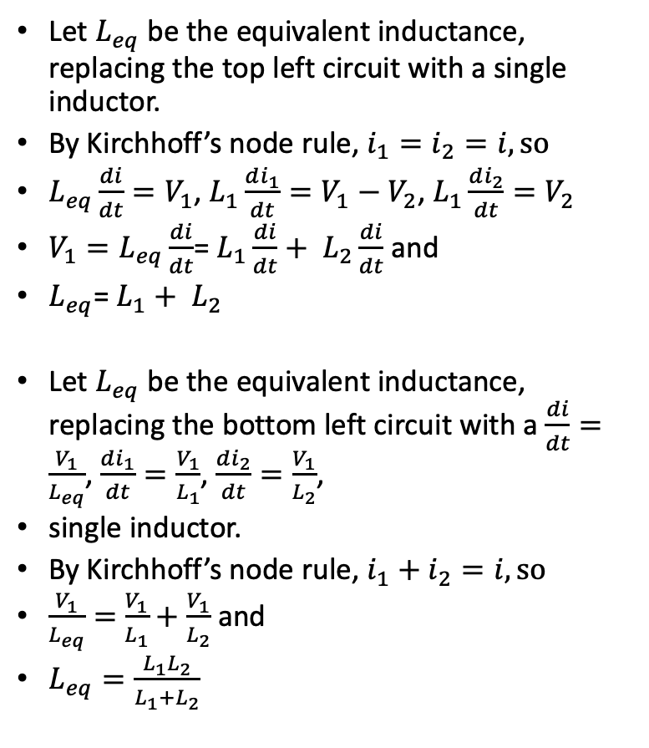
Simple circuit analysis with Kirchhoff
V₁
Let $L_{eq}$ be the equivalent inductance, replacing the top left circuit with a single inductor.
By Kirchhoff’s node rule, $i_{1}=i_{2}=i, so$
$L_{eq}\frac{di}{dt}=V_{1}$, $L_{1}\frac{di_{1}}{dt}=V_{1}−V_{2}$, $L_{1}\frac{di_{2}}{dt}=V_{2}$
${V_{1}=L}_{eq}\frac{di}{dt}$= $L_{1}\frac{di}{dt}+ L_{2}\frac{di}{dt}$ and
$L_{eq}$= $L_{1}+ L_{2}$
Let $L_{eq}$ be the equivalent inductance, replacing the bottom left circuit with a $\frac{di}{dt}=\frac{V_{1}}{L_{eq}}$, $\frac{di_{1}}{dt}=\frac{V_{1}}{L_{1}}$, $\frac{di_{2}}{dt}=\frac{V_{1}}{L_{2}}$,
single inductor.
By Kirchhoff’s node rule, $i_{1}+i_{2}=i, so$
$\frac{V_{1}}{L_{eq}}=$ $\frac{V_{1}}{L_{1}}+\frac{V_{1}}{L_{2}}$ and
$L_{eq}=\frac{L_{1}L_{2}}{L_{1}+L_{2}}$
L₁
i₁
i
V₂
L₂
i₂
The circuit on the right, is useful and is called a voltage divider.
$i=i_{1}=i_{2}$ so $\frac{V_{1}−V_{2}}{R_{1}}= \frac{V_{2}}{R_{2}}$, $V_{1}−V_{2}=\frac{R_{1}}{R_{2}}V_{2}$
Thus, $V_{1}=(1+\frac{R_{1}}{R_{2}})V_{2}$ and so
$V_{2}= \frac{R_{2}}{R_{1}+R_{2}}V_{1}$
V=0
V₁
R₁
i₁
i
V₁
V₂
R₂
i₂
i
L₁
L₂
V=0
i₁
i₂
V=0

Slide 8


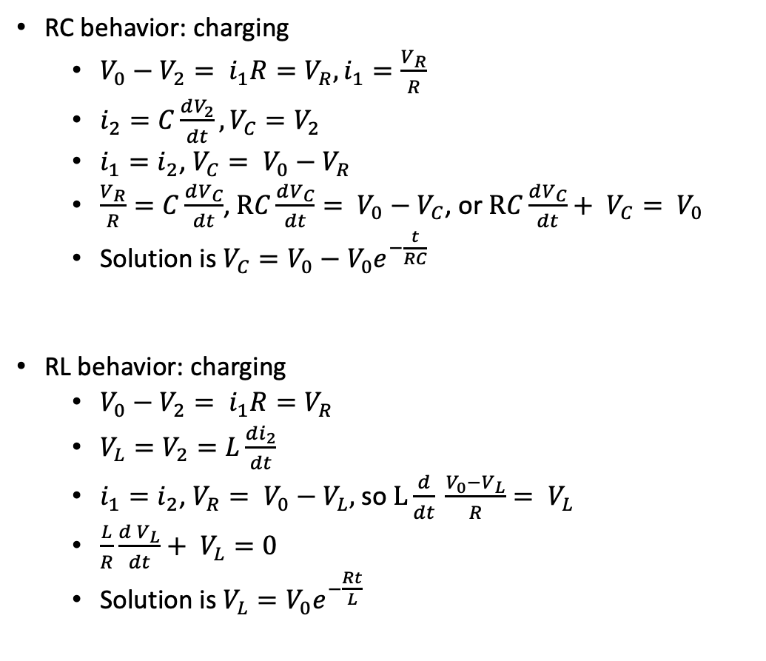
RC/RL circuit analysis with Kirchhoff
RC behavior: charging
$V_{0}−V_{2}= i_{1}R=V_{R}, i_{1}=\frac{V_{R}}{R}$
$i_{2}=C\frac{dV_{2}}{dt},V_{C}=V_{2}$
$i_{1}=i_{2}$, $V_{C}= V_{0}−V_{R}$
$\frac{V_{R}}{R}=C\frac{dV_{C}}{dt}$,$RC\frac{dV_{C}}{dt}= V_{0}−V_{C}$, or $RC\frac{dV_{C}}{dt}+ V_{C}= V_{0}$
Solution is $V_{C}=V_{0}−V_{0}e^{−\frac{t}{RC}}$
RL behavior: charging
$V_{0}−V_{2}= i_{1}R=V_{R}$
$V_{L}=V_{2}=L\frac{di_{2}}{dt}$
$i_{1}=i_{2}$, $V_{R}= V_{0}−V_{L},$ so $L\frac{d}{dt} \frac{V_{0}−V_{L}}{R}= V_{L}$
$\frac{L}{R}\frac{d V_{L}}{dt}+ V_{L}=0$
Solution is $V_{L}=V_{0}e^{−\frac{Rt}{L}}$
V₀
R
i₁
+
V₂
-
C
i₂
V₀
R
i₁
+
V₂
-
L
i₂
C₂

Slide 9
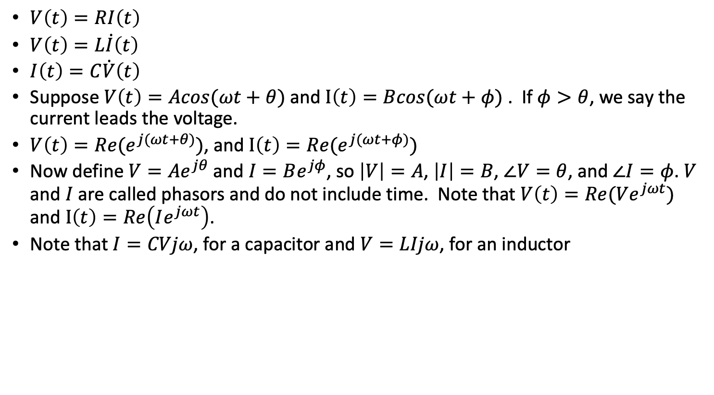
Phasors
$V\left(t\right)=RI\left(t\right)$
$V\left(t\right)=L\dot{I}\left(t\right)$
$I\left(t\right)=C\dot{V}\left(t\right)$
Suppose $V\left(t\right)=Acos(ωt+θ)$ and $I\left(t\right)=Bcos(ωt+φ)$ . If $φ>θ$, we say the current leads the voltage.
$V\left(t\right)=Re(e^{j(ωt+θ)})$, and $I\left(t\right)=Re(e^{j(ωt+φ)})$
Now define $V=Ae^{jθ}$ and $I=Be^{jφ}$, so $\left|V\right|=A$, $\left|I\right|=B$, $∠V=θ$, and $∠I=φ$. $V$ and $I$ are called phasors and do not include time. Note that $V\left(t\right)=Re(Ve^{jωt})$ and $I\left(t\right)=Re\left(Ie^{jωt}\right)$.
Note that $I=CVjω$, for a capacitor and $V=LIjω$, for an inductor

Slide 10
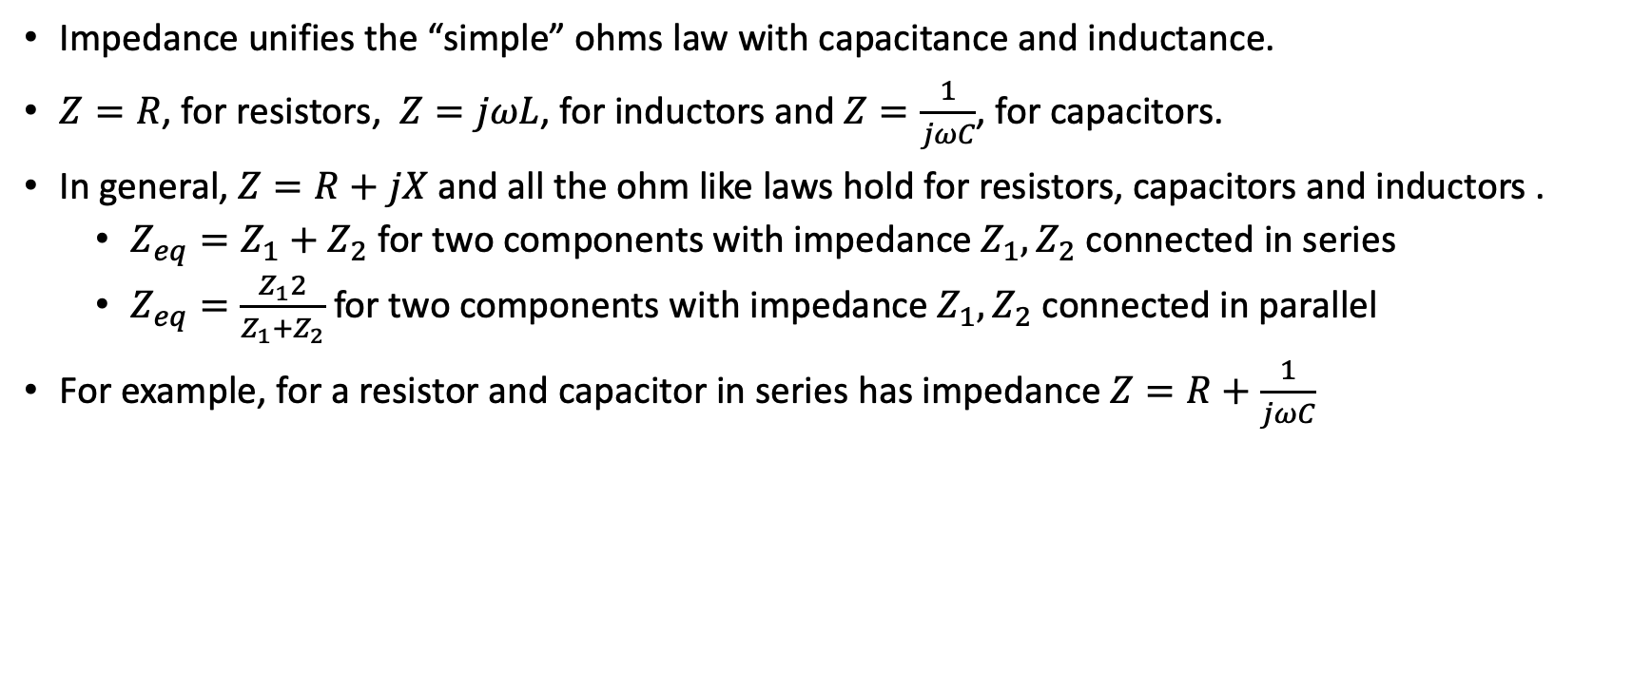
Circuit analysis and impedance
Impedance unifies the “simple” ohms law with capacitance and inductance.
$Z=R$, for resistors, $Z=jωL$, for inductors and $Z=\frac{1}{jωC}$, for capacitors.
In general, $Z=R+jX$ and all the ohm like laws hold for resistors, capacitors and inductors .
$Z_{eq}=Z_{1}+Z_{2}$ for two components with impedance $Z_{1}, Z_{2}$ connected in series
$Z_{eq}=\frac{Z_{1}2}{Z_{1}+Z_{2}}$ for two components with impedance $Z_{1}, Z_{2}$ connected in parallel
For example, for a resistor and capacitor in series has impedance $Z=R+\frac{1}{jωC}$

Slide 11
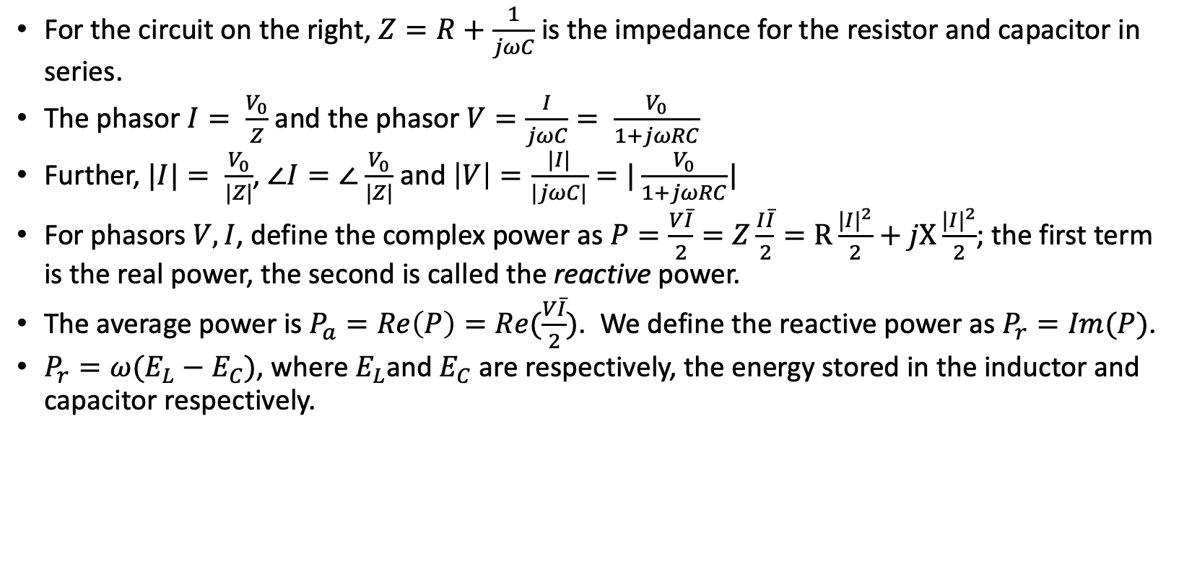
Phasors, impedance and power
For the circuit on the right, $Z=R+\frac{1}{jωC}$ is the impedance for the resistor and capacitor in series.
The phasor $I= \frac{V_{0}}{Z}$ and the phasor $V=\frac{I}{jωC}= \frac{V_{0}}{1+jωRC}$
Further, $|I|= \frac{V_{0}}{|Z|}$, $∠I=∠$ $\frac{V_{0}}{|Z|}$ and $\left|V\right|=\frac{|I|}{|jωC|}=|\frac{V_{0}}{1+jωRC}$|
For phasors $V,I$, define the complex power as $P=\frac{V\overline{I}}{2}=Z\frac{I\overline{I}}{2}=R\frac{{|I|}^{2}}{2}+jX\frac{{|I|}^{2}}{2}$; the first term is the real power, the second is called the reactive power.
The average power is $P_{a}=Re\left(P\right)=Re(\frac{V\overline{I}}{2})$. We define the reactive power as $P_{r}=Im(P)$.
$P_{r}=ω(E_{L}−E_{C})$, where $E_{L}$and $E_{C}$ are respectively, the energy stored in the inductor and capacitor respectively.
R
V₀
C
I
V

Slide 12
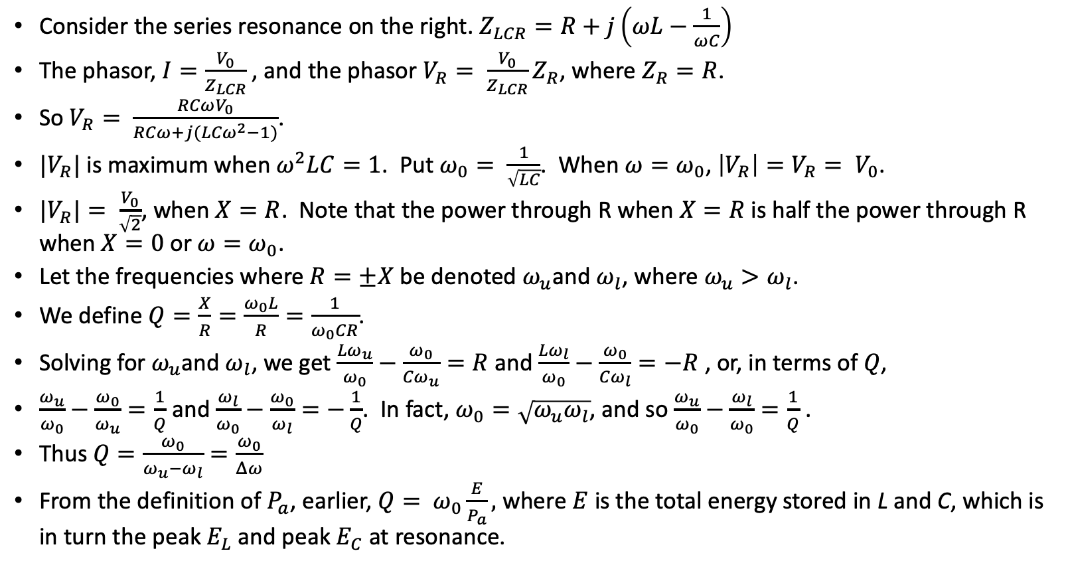
Q and phasors
Consider the series resonance on the right. $Z_{LCR}=R+j\left(ωL−\frac{1}{ωC}\right)$
The phasor, $I=\frac{V_{0}}{Z_{LCR}}$, and the phasor $V_{R}= \frac{V_{0}}{Z_{LCR}}Z_{R}$, where $Z_{R}=R$.
So $V_{R}= \frac{RCωV_{0}}{RCω+j({LCω}^{2}−1)}$.
$|V_{R}|$ is maximum when$ω^{2}LC=1$. Put $ω_{0}= \frac{1}{\sqrt{LC}}$. When $ω=ω_{0}$, $\left|V_{R}\right|=V_{R}= V_{0}$.
${|V}_{R}|= \frac{V_{0}}{\sqrt{2}}$, when $X=R$. Note that the power through R when $X=R$ is half the power through R when $X=0$ or $ω=ω_{0}$.
Let the frequencies where $R=±X$ be denoted $ω_{u}$and $ω_{l}$, where $ω_{u}>ω_{l}$.
We define $Q=\frac{X}{R}=\frac{ω_{0}L}{R}=\frac{1}{ω_{0}CR}$.
Solving for $ω_{u}$and $ω_{l}$, we get $\frac{{Lω}_{u}}{ω_{0}}−\frac{ω_{0}}{{Cω}_{u}}=R$ and $\frac{{Lω}_{l}}{ω_{0}}−\frac{ω_{0}}{{Cω}_{l}}=−R$ , or, in terms of $Q$,
$\frac{ω_{u}}{ω_{0}}−\frac{ω_{0}}{ω_{u}}=\frac{1}{Q}$ and $\frac{ω_{l}}{ω_{0}}−\frac{ω_{0}}{ω_{l}}=−\frac{1}{Q}$. In fact, $ω_{0}=\sqrt{ω_{u}ω_{l}}$, and so $\frac{ω_{u}}{ω_{0}}−\frac{ω_{l}}{ω_{0}}=\frac{1}{Q}$ .
Thus $Q=\frac{ω_{0}}{ω_{u}−ω_{l}}=\frac{ω_{0}}{Δω}$
From the definition of $P_{a}$, earlier, $Q= ω_{0}\frac{E}{P_{a}},$ where $E$ is the total energy stored in L and C, which is in turn the peak $E_{L}$ and peak $E_{C}$ at resonance.
L
C
V₀
R
V_{R}

Slide 13
Phasors, impedance and power
For the circuit on the right, $Z=R+\frac{1}{jωC}$ is the impedance for the resistor and capacitor in series.
The phasor $I= \frac{V_{0}}{Z}$ and the phasor $V=\frac{I}{jωC}= \frac{V_{0}}{1+jωRC}$
Further, $|I|= \frac{V_{0}}{|Z|}$, $∠I=∠$ $\frac{V_{0}}{|Z|}$ and $\left|V\right|=\frac{|I|}{|jωC|}=|\frac{V_{0}}{1+jωRC}$|
For phasors $V,I$, define the complex power as $P=\frac{V\overline{I}}{2}=Z\frac{I\overline{I}}{2}=R\frac{{|I|}^{2}}{2}+jX\frac{{|I|}^{2}}{2}$; the first term is the real power, the second is called the reactive power.
The average power is $P_{a}=Re\left(P\right)=Re(\frac{V\overline{I}}{2})$. We define the reactive power as $P_{r}=Im(P)$.
$P_{r}=ω(E_{L}−E_{C})$, where $E_{L}$and $E_{C}$ are respectively, the energy stored in the inductor and capacitor respectively.
R
V₀
C
I
V

Slide 14
Thevenin and Norton
Thevenin: Any combination of linear sources and passive elements terminating in two terminals is equivalent to a pure voltage source in series with an impedance
Norton: Any combination of linear sources and passive elements terminating in two terminals is equivalent to a pure current source in parallel with a conductance
Similar theorems for two terminal input and output devices (with transfer function)
Z_{Th}
V_{Th}
I_{N}
G_{Th}

Slide 15
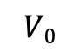
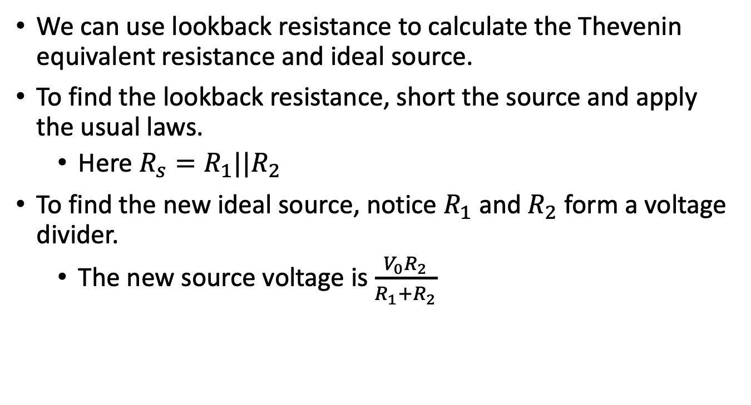
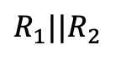
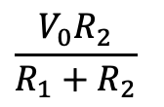
Thevenin and Norton
R₁
We can use lookback resistance to calculate the Thevenin equivalent resistance and ideal source.
To find the lookback resistance, short the source and apply the usual laws.
Here $R_{s}=R_{1}||R_{2}$
To find the new ideal source, notice $R_{1}$ and $R_{2}$ form a voltage divider.
The new source voltage is $\frac{V_{0}R_{2}}{R_{1}+R_{2}}$
$$V0$$
R₂
Is equivalent to
$$R_{1}||R_{2}$$
$$\frac{V_{0}R_{2}}{R_{1}+R_{2}}$$

Slide 16
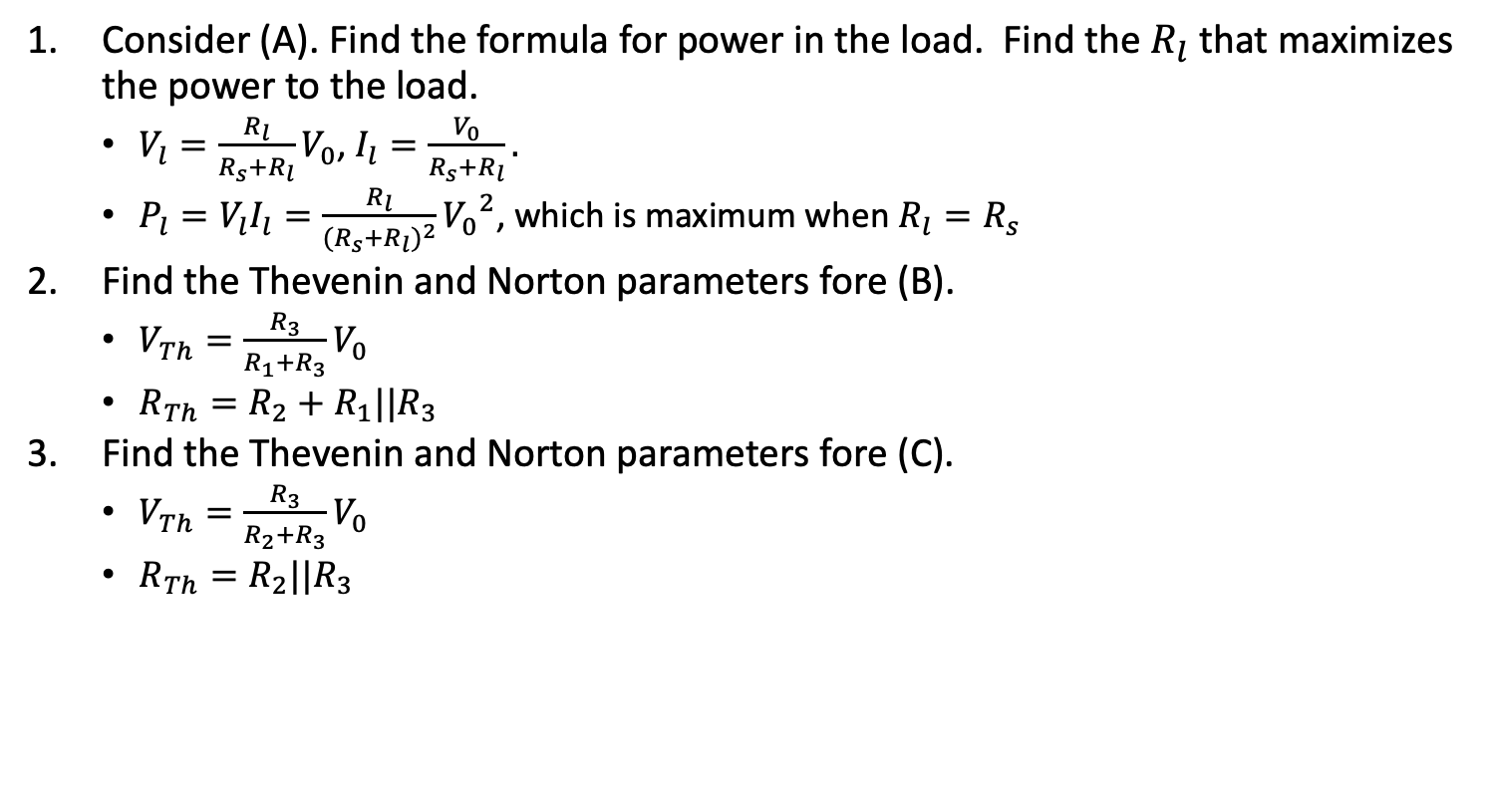
Exercise 1: Resistors
R_{s}
V_{l}
+
A
V₀
Consider (A). Find the formula for power in the load. Find the $R_{l}$ that maximizes the power to the load.
$V_{l}=\frac{R_{l}}{R_{s}+R_{l}}V_{0}$, $I_{l}=\frac{V_{0}}{R_{s}+R_{l}}.$
$P_{l}=V_{l}I_{l}=\frac{R_{l}}{{(R_{s}+R_{l})}^{2}}{V_{0}}^{2}$, which is maximum when $R_{l}=R_{s}$
Find the Thevenin and Norton parameters fore (B).
$V_{Th}=\frac{R_{3}}{R_{1}+R_{3}}V_{0}$
$R_{Th}=R_{2}+R_{1}||R_{3}$
Find the Thevenin and Norton parameters fore (C).
$V_{Th}=\frac{R_{3}}{R_{2}+R_{3}}V_{0}$
$R_{Th}=R_{2}||R_{3}$
-
R_{l}
R₁
R₂
+
R₃
B
V₀
-
R₂
+
R₁
R₃
V₀
C
-

Slide 17
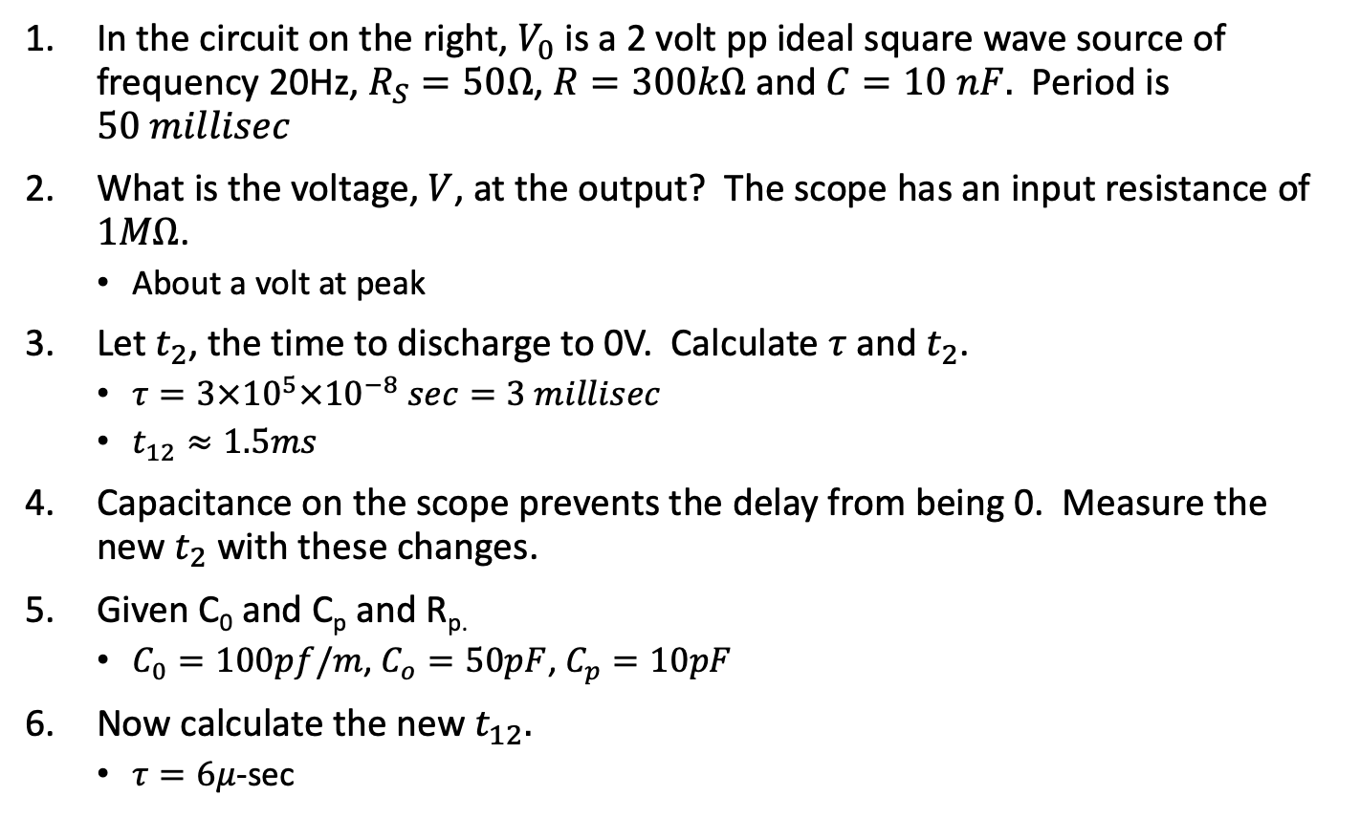
Exercise 3: Capacitors
In the circuit on the right, $V_{0}$ is a 2 volt pp ideal square wave source of frequency 20Hz, $R_{S}=50Ω$, $R=300kΩ$ and $C=10 nF.$ Period is $50 millisec$
What is the voltage, $V$, at the output? The scope has an input resistance of $1MΩ$.
About a volt at peak
Let $t_{2}$, the time to discharge to 0V. Calculate $τ$ and $t_{2}$.
$τ=3×{10}^{5}×{10}^{−8} sec=3 millisec$
$t_{12}≈1.5ms$
Capacitance on the scope prevents the delay from being 0. Measure the new $t_{2}$ with these changes.
Given C₀ and C_{p} and R_{p.}
$C_{0}=100pf/m$, $C_{o}=50pF$, $C_{p}=10pF$
Now calculate the new $t_{12}.$
$τ=6μ$-sec
R_{s}
R
C
V
V₀
Probe
R_{p}
C_{c}
V
V_{i}
C_{p}
C_{o}
R₀

Slide 18
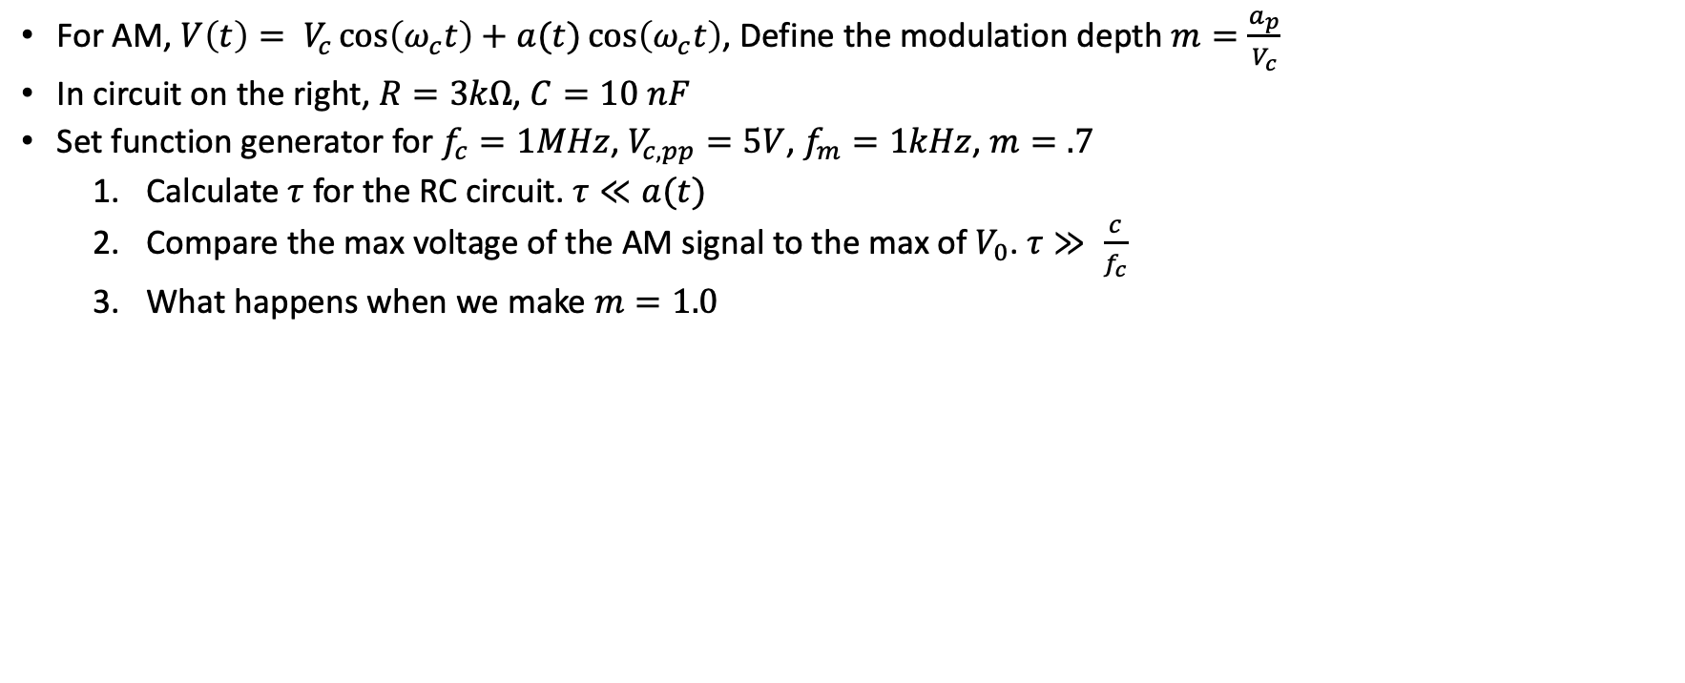
Exercise 4: Diode detectors
V_{i}
R
C
V_{o}
For AM, $V\left(t\right)= V_{c}\cos\left(ω_{c}t\right)+a(t)\cos\left(ω_{c}t\right)$, Define the modulation depth $m=\frac{a_{p}}{V_{c}}$
In circuit on the right, $R=3kΩ$, $C=10 nF$
Set function generator for $f_{c}=1MHz$, $V_{c,pp}=5V$, $f_{m}=1kHz$, $m=.7$
Calculate $τ$ for the RC circuit. $τ≪a(t)$
Compare the max voltage of the AM signal to the max of $V_{0}$. $τ≫ \frac{c}{f_{c}}$
What happens when we make $m=1.0$

Slide 19
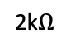
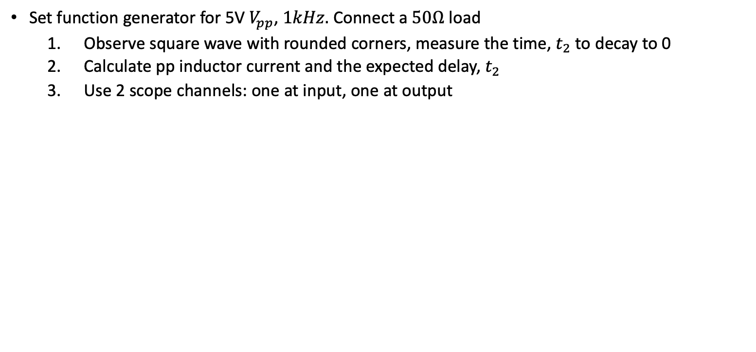
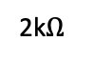
Exercise 5: Inductors
1 mH
V_{i}
V_{o}
Set function generator for 5V $V_{pp}$, $1kHz.$ Connect a $50Ω$ load
Observe square wave with rounded corners, measure the time, $t_{2}$ to decay to 0
Calculate pp inductor current and the expected delay, $t_{2}$
Use 2 scope channels: one at input, one at output
8V
2k$Ω$
2N2222A
out
2k$Ω$

Slide 20
Exercise 6: Diodes and snubbers
x

Slide 21
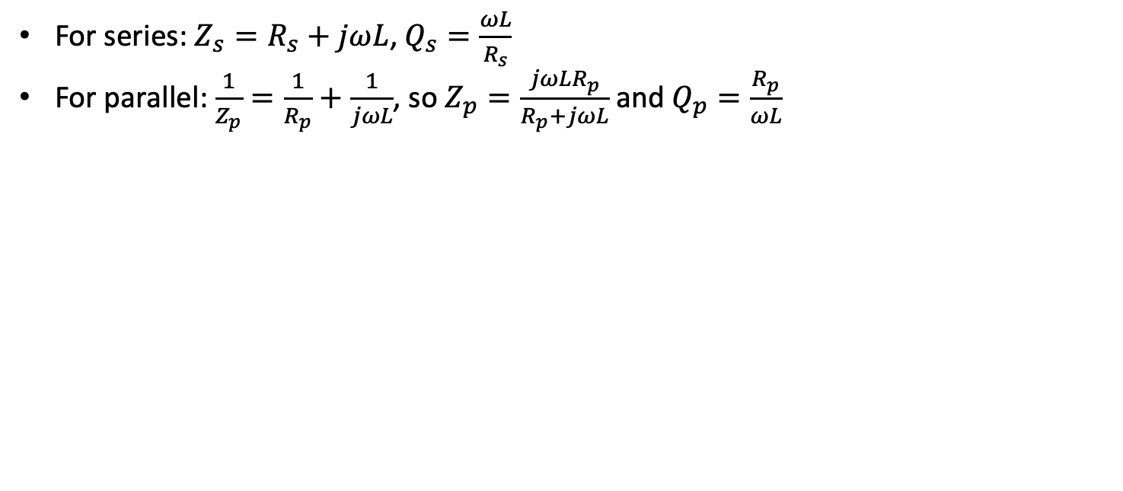
Exercise 7: Parallel to Series conversion
For series: $Z_{s}=R_{s}+jωL$, $Q_{s}=\frac{ωL}{R_{s}}$
For parallel: $\frac{1}{Z_{p}}=\frac{1}{R_{p}}+\frac{1}{jωL}$, so $Z_{p}=\frac{jωLR_{p}}{R_{p}+jωL}$ and $Q_{p}=\frac{R_{p}}{ωL}$
V
R_{p}
jX_{p}
V
R_{s}
V₂
jX_{s}
L
V
C
50ohms

Slide 22
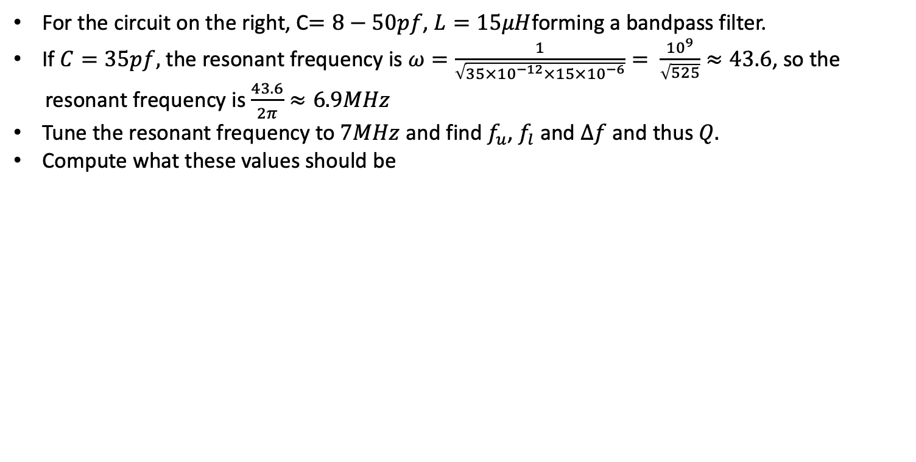
Exercise 8: Series resonance
C
L
For the circuit on the right, C$=8−50pf$, $L=15μH$forming a bandpass filter.
If $C=35pf,$ the resonant frequency is $ω=\frac{1}{\sqrt{35×{10}^{−12}×15×{10}^{−6}}}= \frac{{10}^{9}}{\sqrt{525}}≈43.6$, so the
resonant frequency is $\frac{43.6}{2π}≈6.9MHz$
Tune the resonant frequency to $7MHz$ and find $f_{u}$, $f_{l}$ and $∆f$ and thus $Q.$
Compute what these values should be

Slide 23
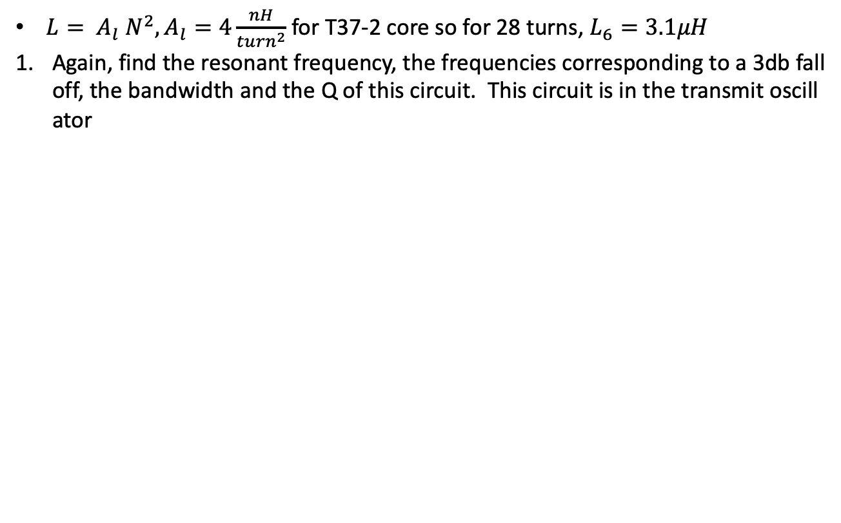
Exercise 9: Parallel resonance
$L= A_{l} N^{2}, A_{l}=4\frac{nH}{{turn}^{2}}$ for T37-2 core so for 28 turns, $L_{6}=3.1μH$
Again, find the resonant frequency, the frequencies corresponding to a 3db falloff, the bandwidth and the Q of this circuit. This circuit is in the transmit oscillator
C₃₇
5pF
C₃₈
100pF
L₆

Slide 24
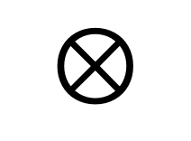
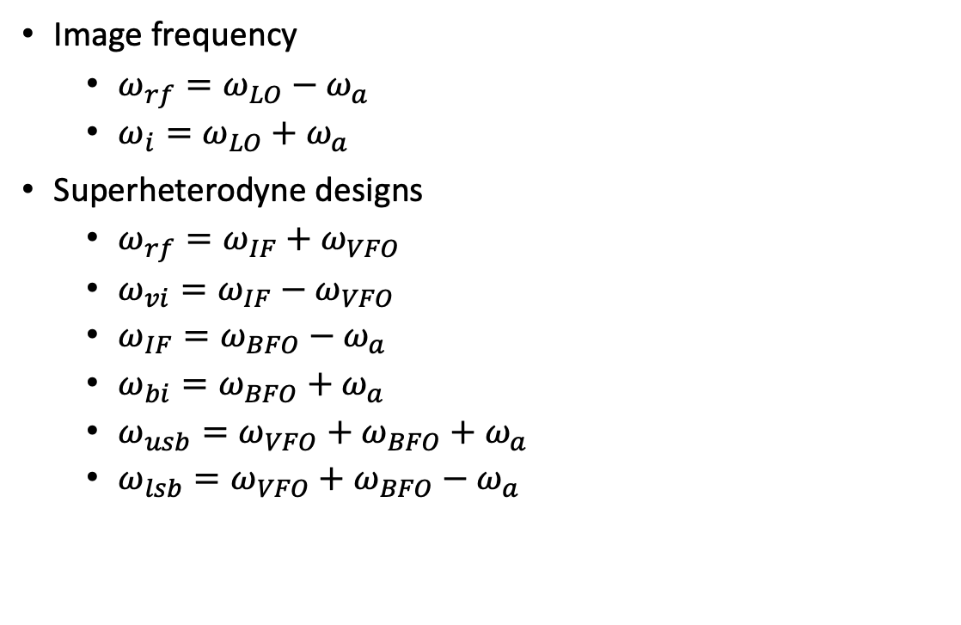
Direct conversion and superhet receivers
Image frequency
$ω_{rf}=ω_{LO}−ω_{a}$
$ω_{i}=ω_{LO}+ω_{a}$
Superheterodyne designs
$ω_{rf}=ω_{IF}+ω_{VFO}$
$ω_{vi}=ω_{IF}−ω_{VFO}$
$ω_{IF}=ω_{BFO}−ω_{a}$
$ω_{bi}=ω_{BFO}+ω_{a}$
$ω_{usb}=ω_{VFO}+ω_{BFO}+$ $ω_{a}$
$ω_{lsb}=ω_{VFO}+ω_{BFO}−$ $ω_{a}$
RF
Filter
$$⊗$$
RF Mixer
LO
Audio
Amp
Direct conversion

Slide 25
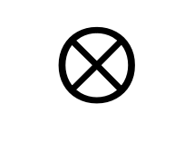
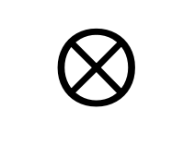
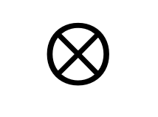
Norcal 40A
7 MHz
2W
<10 MHz
Harmonic
Filter
RF
Filter
Power
Amp
$$⊗$$
RF Mixer
20 mW
4.9 MHz
9.1 MHz
Driver
IF Filter
300 uW
VFO
2.1 MHz
Product
Detector
Buffer
$$⊗$$
BFO
4.9 MHz
10 uW
9.8 MHz
Audio
Transmit
Filter
AGC
7 MHz
2.8 MHz
Transmit
Mixer
$$⊗$$
AGC
Detector
Audio
Amp
Key
Transmit oscillator
4.9 MHz

Slide 26
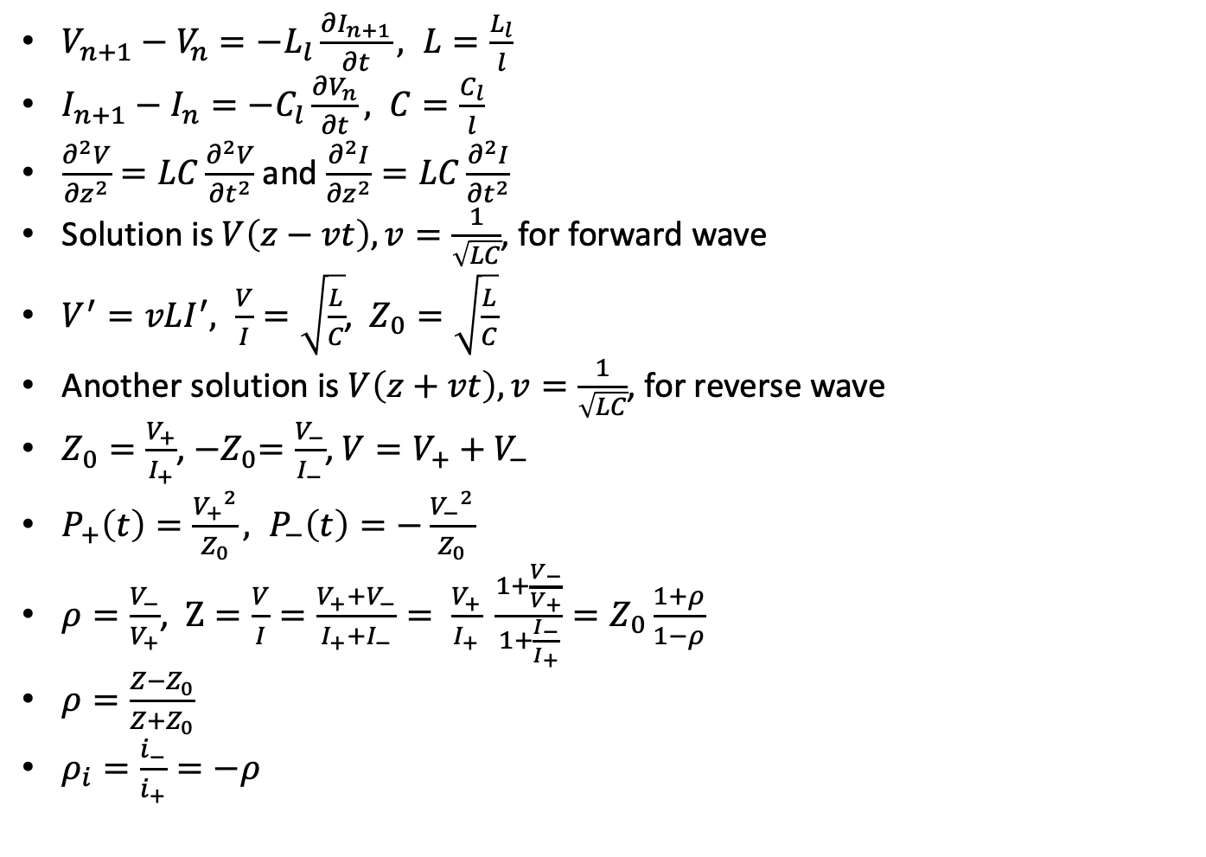
Transmission Lines
I_{n}
V_{n}
$V_{n+1}−V_{n}=−L_{l}\frac{∂I_{n+1}}{∂t}, L=\frac{L_{l}}{l}$
$I_{n+1}−I_{n}=−C_{l}\frac{∂V_{n}}{∂t}, C=\frac{C_{l}}{l}$
$\frac{∂^{2}V}{{∂z}^{2}}=LC\frac{∂^{2}V}{{∂t}^{2}}$ and $\frac{∂^{2}I}{{∂z}^{2}}=LC\frac{∂^{2}I}{{∂t}^{2}}$
Solution is $V\left(z−vt\right), v=\frac{1}{\sqrt{LC}}$, for forward wave
$V^{′}=vLI^{′}, \frac{V}{I}=\sqrt{\frac{L}{C}}$, $Z_{0}=\sqrt{\frac{L}{C}}$
Another solution is $V\left(z+vt\right), v=\frac{1}{\sqrt{LC}}$, for reverse wave
$Z_{0}=\frac{V_{+}}{I_{+}}$, ${−Z}_{0}=\frac{V_{−}}{I_{−}}$, $V=V_{+}+V_{−}$
$P_{+}\left(t\right)=\frac{{V_{+}}^{2}}{Z_{0}}, P_{−}\left(t\right)=−\frac{{V_{−}}^{2}}{Z_{0}}$
$ρ=\frac{V_{−}}{V_{+}}$, $Z=\frac{V}{I}=\frac{V_{+}+V_{−}}{I_{+}+I_{−}}= \frac{V_{+}}{I_{+}} \frac{1+\frac{V_{−}}{V_{+}}}{1+\frac{I_{−}}{I_{+}}}=Z_{0}\frac{1+ρ}{1−ρ}$
$ρ=\frac{Z−Z_{0}}{Z+Z_{0}}$
$ρ_{i}=\frac{i_{−}}{i_{+}}=−ρ$
L_{l}
…
C_{l}

Slide 27
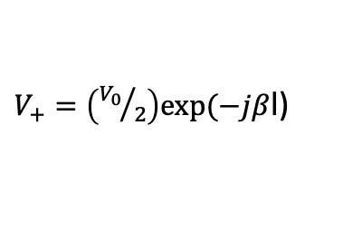
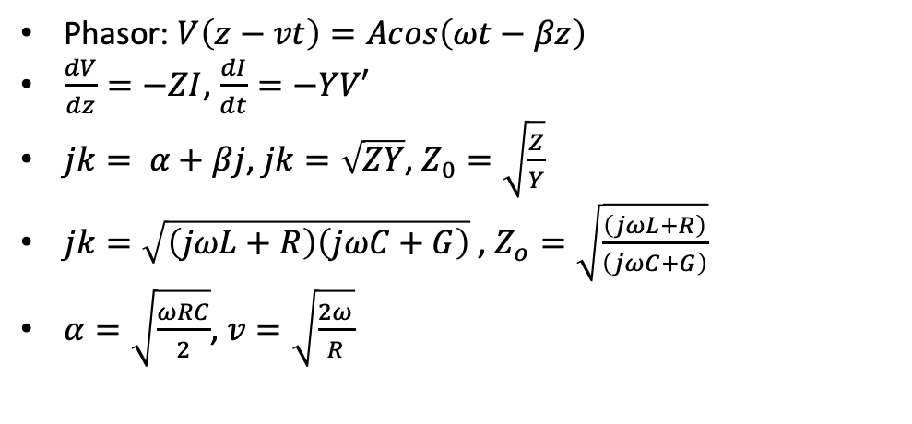

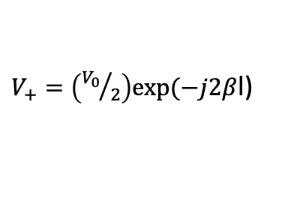
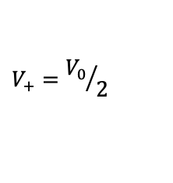
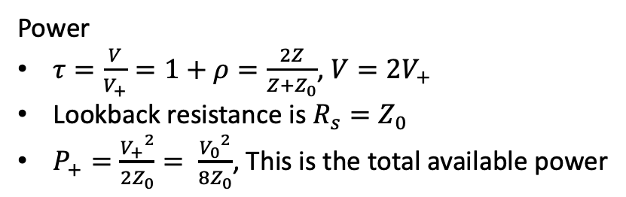
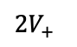
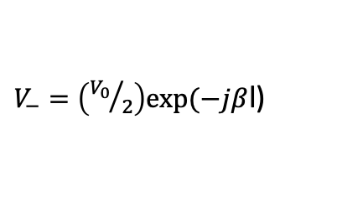
Transmission Lines - continued
$V_{+}=\left({V_{0}}/2\right)exp⁡(−jβ$l)
Phasor: $V\left(z−vt\right)=Acos\left(ωt−βz\right)$
$\frac{dV}{dz}=−ZI$, $\frac{dI}{dt}=−YV′$
$jk= α+βj$, $jk=\sqrt{ZY}$, $Z_{0}=\sqrt{\frac{Z}{Y}}$
$jk=\sqrt{\left(jωL+R\right)\left(jωC+G\right)}$ , $Z_{o}=\sqrt{\frac{\left(jωL+R\right)}{\left(jωC+G\right)}}$
$α=\sqrt{\frac{ωRC}{2}}$, $v=\sqrt{\frac{2ω}{R}}$
$$V_{+}={V_{0}}/2$$
Z₀
Z₀
$$l$$
V
V_{g}
$V_{−}=\left({V_{0}}/2\right)exp⁡(−jβ$l)
V₀
$V_{+}=\left({V_{0}}/2\right)exp⁡(−j2β$l)
Power
$τ=\frac{V}{V_{+}}=1+ρ=\frac{2Z}{Z+Z_{0}}$, $V=2V_{+}$
Lookback resistance is $R_{s}=Z_{0}$
$P_{+}=\frac{{V_{+}}^{2}}{2Z_{0}}= \frac{{V_{0}}^{2}}{8Z_{0}}$, This is the total available power
V₊
Z₀
$${2V}_{+}$$
Z₀

Slide 28
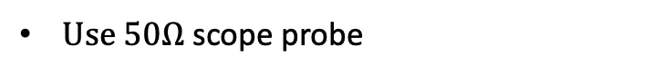
Exercise 10: Coax
$Use 50Ω$ scope probe
10m

Slide 29

Exercise 11: Waves
$Use 50Ω$ scope probe

Slide 30
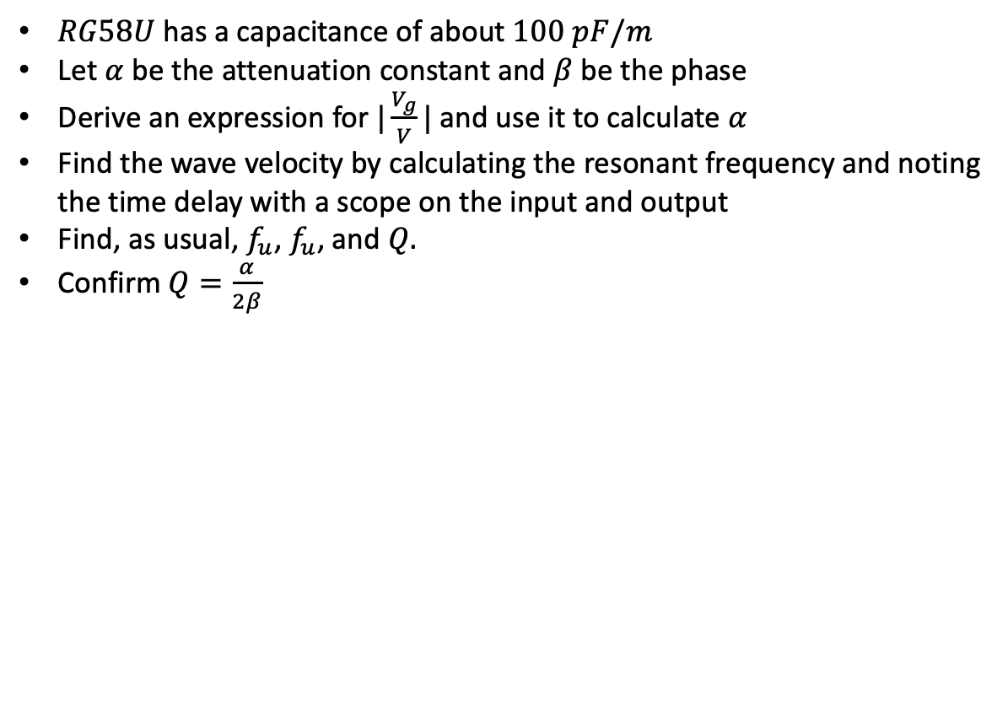
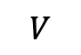
Exercise 12: Resonance
10m
$RG58U$ has a capacitance of about $100 pF/m$
Let $α$ be the attenuation constant and $β$ be the phase
Derive an expression for $|\frac{V_{g}}{V}|$ and use it to calculate $α$
Find the wave velocity by calculating the resonant frequency and noting the time delay with a scope on the input and output
Find, as usual, $f_{u}$, $f_{u}$, and $Q.$
Confirm $Q=\frac{α}{2β}$
Z₀
$$V$$

Slide 31


Filters
Low pass
L₂
L₄
Filters
C₁
C₂
C₃
High pass
C₁
C₂
C₃
Bandpass - WIkipedia
L₂
L₄
7 MHz bandpass
C₁ (34.5 pF)
L₂ (15 uH)
C₂ (6nF)
L₄ (8nH)
Lowpass - WIkipedia

Slide 32
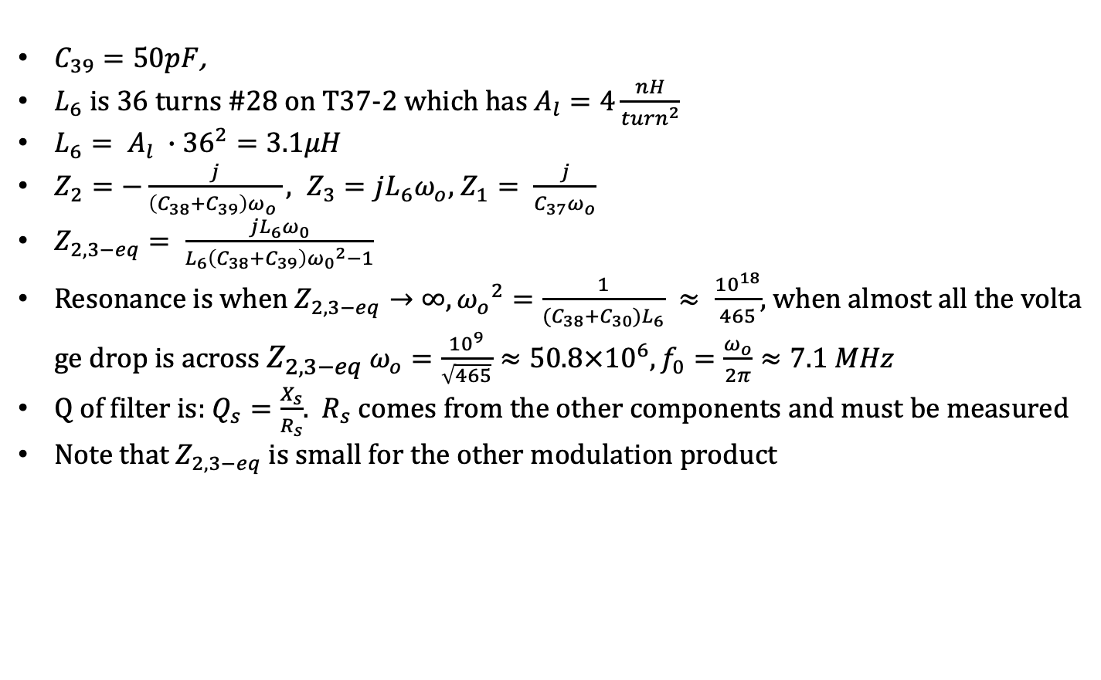
Norcal transmit bandpass filter
$C_{39}=50pF$,
$L_{6}$ is 36 turns #28 on T37-2 which has $A_{l}=4\frac{nH}{{turn}^{2}}$
$L_{6}= A_{l} ∙{36}^{2}=3.1μH$
$Z_{2}=−\frac{j}{\left(C_{38}+C_{39}\right)ω_{o} }, Z_{3}=jL_{6}ω_{o}$, $Z_{1}= \frac{j}{C_{37}ω_{o}}$
$Z_{2,3−eq}= \frac{jL_{6}ω_{0}}{L_{6}\left(C_{38}+C_{39}\right){ω_{0}}^{2}−1}$
Resonance is when $Z_{2,3−eq}→∞, {ω_{o}}^{2}=\frac{1}{(C_{38}+C_{30})L_{6}} ≈ \frac{{10}^{18}}{465}$, when almost all the voltage drop is across $Z_{2,3−eq}$ $ω_{o}=\frac{{10}^{9}}{\sqrt{465}}≈50.8×{10}^{6}, f_{0}=\frac{ω_{o}}{2π}≈7.1 MHz$
Q of filter is: $Q_{s}=\frac{X_{s}}{R_{s}}$. $R_{s}$ comes from the other components and must be measured
Note that $Z_{2,3−eq}$ is small for the other modulation product
C37 (5pF)
C₃₉
C₃₈ (100pF)
L₆

Slide 33
Norcal RF Filter
C₁
50 pF
L₁
15uH
RX Ant
8V TX
2N4124
To RF
Mixer
R₁
1.8K
R₂
1K
C₃
47nF
To receiver
switch

Slide 34
Exercise 13: Norcal Harmonic Filter
L₇
L₈
Power amp, or,
function generator
C₄₅
330pF
Antenna
Jack out
L₇, L₈ use T37-2 core, 18 turns, 1.3uH
Compare loss at 7MHz and 14MHz
C₄₆
820pF
C₄₇
330pF

Slide 35
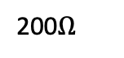
Exercise 14: Norcal IF Cohn Filter
C₉
X₁
X₂
X₃
X₄
C₁₃
X₁ through X₄ are 4.91 MHz
C₁₀, C₁₁, C₁₂ are 270 pF
Set function generator to 50mV_{pp} from function generator
Calculate R and X for filter
C₁₀
C₁₂
C₁₁
L₉ (18 uH)
200$Ω$
C₁₄
47pF
To SA602 wants 1.5K
Matching network
Equivalent circuit for
crystal and generator

Slide 36
Transformers
$V_{s}=\frac{N_{s}}{N_{p}}V_{p}$

Slide 37
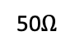
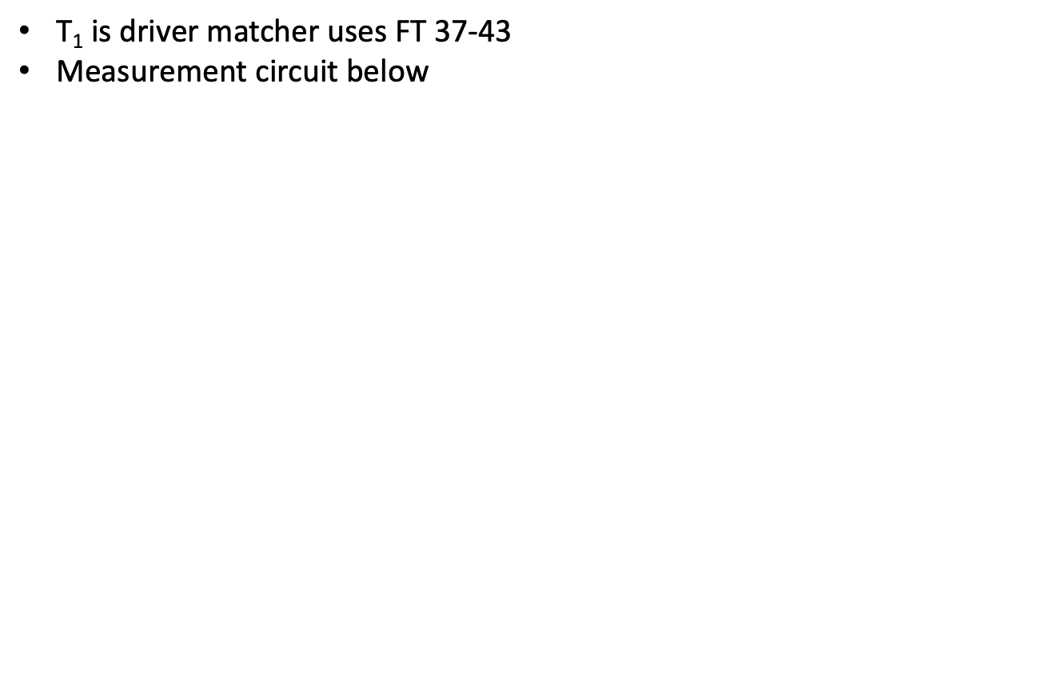
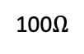
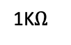
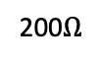
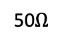
Exercise 15: Norcal Driver Transformers
$\text{T}\text{1} \text{is} \text{driver} \text{matcher} \text{uses} \text{FT}\text{ 37-43}$
$\text{Measurement} \text{circuit} \text{below}$
T₁, 14:4
50$Ω$
200$Ω$
100$Ω$
50$Ω$
1K$Ω$

Slide 38





Exercise 16: Norcal Tuned Transformers
$\text{T}\text{2}\text{, }\text{T}\text{3} \text{are} \text{I}\text{F} \text{matchers} \text{usin}\text{g} \text{FT}\text{ 37-61}$
$\text{Measurement} \text{circuit} \text{below}$
C₄
5pF
T₂, 1:20
50$Ω$
C₂
50pF
1.5K$Ω$
T₃, 23:6
L₄, 18uH
750$Ω$
C₁₄
47pF
C₆
47pF
1.5K$Ω$

Slide 39

Acoustics
Section of air of length $l$, $U$ is average velocity, $P$ is the pressure
$\frac{∂P}{∂z}l=−ρl\frac{∂U}{∂t}$
$\frac{dl}{dt}=l\frac{∂U}{∂z}$
$PV^{γ}=C$
$\frac{∂^{2}P}{{∂t}^{2}}= \frac{γP}{ρ}\frac{∂^{2}P}{{∂x}^{2}}$
$v=\sqrt{\frac{γP}{ρ}}= =332\frac{m}{s}$
$SWR=\frac{λ^{2}}{2πA},$ A is the area of the tube
Sound | L_{p} | Power density
rustling leaves | 10dB | 1pW/m²
broadcast studio | 20dB | 1pW/m²
classroom | 50dB | 10nW/m²
heavy truck | 90dB | 1nW/m²
Shout at 1m | 100dB | 10mW/m²
jackhammer | 110db | 100mW/m²
jet takeoff at 50m | 120dB | 1W/m²

Slide 40
Exercise 17: Tuned Speaker
$x$

Slide 41
Exercise 18: Acoustic Standing Wave
$x$

Slide 42

Bipolar Transistors
NPN, PNP
Model
i_{C} = 𝛼i_{E}
i_{C}= 𝛽i_{B}
𝛽 = 𝛼/(1- 𝛼)
𝛽 ∼ 100
v_{s}
R_{S}
Bipolar source model
b
c
r_{p}
bi_{b}
e
Bipolar equivalent circuit

Slide 43
Bipolar Switches

Slide 44
BJT common emitter amplifier
Here’s how to design a common emitter amplifier. We use a 2n3904 transistor with 𝛽=150. This circuit will work! Build it.
Pick the supply voltage V_{cc}=12V.
Choose a gain (amplification factor), A = 5.
Choose the “Q point” of the conducting transistor (4mA).
V_{cc} = (i_{c}∙R_{C}) + V_{ce} + i_{e} R_{E} ∼ i_{e}∙ (R_{C}+R_{E}) +V_{ce} with i_{c}=4mA. We get (R_{C}+R_{E}) = (V_{cc} - V_{ce})/(4mA) =1.75 k𝝮.
Since A = 5 and A=R_{C}/R_{E}, R_{C}= 5 R_{E} so R_{E} ∼ 270 𝝮 (this is a standard resistor value) and R_{C}= 1.5k𝝮.
V_{CC}
R_{C}
R₁
C_{o}
C_{i}
v_{s}
R₂
v_{s}
R_{E}
Common emitter amp
Credit: Ward, Hands on Radio.

Slide 45
BJT common emitter amplifier continued
i_{b} = 4mA/𝛽 = 27 𝝁A.
Since V_{be} must be greater than .7V throughout the input signal range, we want the voltage across R₂ to satisfy V_{be} + i_{c}R_{E} = 1.8V.
We insert a voltage divider consisting of R₁ and R_{2,} so that R₁= (12-1.8)/270 𝝁A ∼ 39 k𝝮.
C_{o} and C_{i} are picked to offer small resistance to the frequency range we’re interested in and C_{o} = C_{i} = 5 𝝁F.
I haven’t explained why we want R_{E} but it provides thermal stability for the transistor over the range we care about. The fact that A=R_{C}/R_{E} can be calculated using Kirchhoff’s laws.
V_{CC}
R_{C}
R₁
C_{o}
C_{i}
v_{s}
R₂
v_{s}
R_{E}
Common emitter amp
Credit: Ward, Hands on Radio.

Slide 46
BJT common collector amplifier
V_{CC}
d
R₁
C_{i}
C_{o}
v_{s}
R₂
R_{E}
Common collector amp (Emitter Follower)
Common collector amp
Credit: Ward, Hands on Radio.

Slide 47
BJT common collector amplifier continued
x
V_{CC}
R₁
C_{i}
v_{s}
R₂
R_{E}
Common collector amp (Emitter Follower)
Credit: Ward, Hands on Radio.

Slide 48
BJT common base amplifier
x
V_{CC}
C_{i}
R_{C}
R_{E}
R₁
v_{s}
v_{i}
R₂
C_{B}
Common base amp

Slide 49
BJT common base amplifier continued
x
V_{CC}
C_{i}
R_{C}
R_{E}
R₁
v_{i}
R₂
C_{B}
Common base amp

Slide 50

JFETs
JFET circuit model: $I_{ds}=V_{ds}(\frac{2I_{dss}}{{V_{c}}^{2}})(V_{gs}−V_{c}−\frac{V_{ds}}{2})$
Op amp: $V_{out}=A_{OL}(V_{+}−V_{−})$, input resistance is very high

Slide 51
JFET Common Emitter Amplifier
x
R_{D}
C_{out}
C_{in}
G
out
D
in
R_{G}
S
R_{S}
v_{s}
v_{s}

Slide 52
JFET common emitter amplifier continued
x

Slide 53
JFET common source amplifier
d
R_{D}
C_{out}
C_{in}
G
out
D
in
R_{G}
S
R_{S}

Slide 54
JFET Common Source Amplifier continued
x
R_{D}
C_{out}
C_{in}
G
out
D
in
R_{G}
S
R_{S}

Slide 55
JFET common drain amplifier
x
C_{in}
G
D
in
C_{out}
S
R_{G}
out
R_{S}
R_{L}

Slide 56
JFET common drain amplifier continued
x
C_{in}
G
D
in
C_{out}
S
R_{G}
out
R_{S}
R_{L}

Slide 57

CMOS common emitter amplifier
V_{DD}
Pick power
$V_{DD}=i_{D}R_{D}+V_{DS}+i_{D}R_{S}$
$V_{GS}=V_{G}−i_{S}R_{S}$
$V_{G}=V_{DD}\frac{R_{1}}{R_{1}+R_{2}}$
$i_{D}=k{(V_{G}−V_{TH})}^{2}$
Bias around $\frac{V_{DD}}{3}$
Pick gain, $A=\frac{R_{D}}{R_{S}+\frac{1}{g_{m}}}$
R_{D}
D
C_{i}
R₁
C_{o}
S
R₂
R_{S}

Slide 58


Differential Amplifier
Two port model
$\left(\begin{matrix}i_{1} \\ i_{2}\end{matrix}\right)=\left[\begin{matrix}y_{11} & y_{12} \\ y_{21} & y_{22}\end{matrix}\right]\left(\begin{matrix}V_{1} \\ V_{2}\end{matrix}\right)$
Pick power $∓12$
Choose collecter current ($2mA$) by picking $R_{1}$
Pick gain, $A=\frac{R_{C}}{2R_{E}}$
Differential amplifier
R_{C}
R_{C}
v_{in}
v_{O}
v_{in}
R_{E}
R_{E}
R₁

Slide 59

Exercise 19: Norcal receiver switch
Receiver mixer or an oscilloscope with 50$Ω$
When transistor conducts the receiver filter shorts
C₁
50pF
L₁ (15uH)
8V TX
Harmonic filter
2N4124
R₁
1.8K
C₂
47nF
If using function generator
use a 1.8K resistor

Slide 60
Exercise 20: NorCal transmitter switch
When key is down, transistor conducts
2N3906
8V
8V TX
R₂₄ (150K)
R₉ (47K)
Key jack
C₄₇ (47nF)
relay

Slide 61





Exercise 21: Norcal Driver
$Use 50Ω$ scope probe
8V
out
T₁
R₁₄
100$Ω$
2N2222A
R₁₁
510$Ω$
R₁₂
20$Ω$
R₁₃
500$Ω$
+
Key jack
C₅₆
10uF
C₄₈
10nF

Slide 62

Exercise 22: Emitter degeneration
$Use 50Ω$ scope probe

Slide 63



Exercise 23: Norcal Buffer amplifier
$$G_{V}=\frac{V}{V_{i} }$$
8V TX
C₃₆
47nF
Function
Generator
C₃₉
50pF
Pin 4 transmit
mixer
C₃₇
5pF
R₁₀
510$Ω$
1.5K
Driver
C₃₈
100pF
C₅₀
25pF
L₆
3.1uF
J309
R₁₁
510$Ω$

Slide 64

Amplifier classes
I
I
V
Class Efficiency Characteristics
A 35% Full bias
B 60% Low bias
C 75% Saturating
D 75% Switch in pass-band
E 90% Voltage switch
F 80% Harmonic resonators
$$η= \frac{P}{P_{0}}, P_{d}=P_{0}−P_{i}$$
$$P_{d}=P_{a}+P_{on}$$
t
t
t
Class A
Class B
Class C
V
V
V
t
t
t
Class D
Class E
Class F

Slide 65



Exercise 24: Norcal Power Amp
Norcal-40 Power amp is class C
8V
R₁₄
1$Ω$
Supply power
3,200 mW
RFC
18uH
Harmonic
Filter
2N3553
Active loss
P_{a}, 260 mW
Driver
C₄₄
47nF
IN4753A
Power transistor
R₁₄
100$Ω$
Active loss
P_{on}, 430 mW
$R_{t}=\frac{T−T_{0}}{P_{d}}$
$T_{0}$ is ambient temperature, $T$ is heat sink temperature
Antenna
2500 mW

Slide 66

Exercise 25: Power modelling
$Use 50Ω$ scope probe

Slide 67

Clapp oscillator
$i_{d}=g_{m}v_{gs}$
Resonance: $−\frac{1}{jω_{0}C_{2}}=jω_{0}L+\frac{1}{jω_{0}C_{3}}+\frac{1}{jω_{0}C_{1}}$
$ω_{0}=\frac{1}{\sqrt{LC}}$, $C= C_{1}|\left|C_{2}\right||C_{3}$
At resonance, $v_{gs}=Ri_{d}\frac{C_{1}}{C_{2}}$, $L=\frac{C_{1}}{RC_{2}}$
Oscillation continues if $g_{m}>\frac{C_{1}}{RC_{2}}$
$v_{gs}=2v_{s}$
9v
C₃
C₁ (1200pF)
L (19uH)
C₂ (1200 pF)
out
R

Slide 68
Norcal Receiver Incremental Tuning (RIT)
LM393 is a comparator
For function generator connect through 1.5K
RIT 1
R₁₆
1K
R₁₅
510
LM393
8
1
7
8V
2
3
C₄
5pF
6
4
5
on
1.4V
From VFO
off
8V TX

Slide 69

Exercise 26: Norcal VFO
RIT 1
R₁₇
10K
R₂₀
4.7K
L9: T68-7 62 turns
Check MVAM108 capacitor when R₁₇ is high and low
Start resistor (R₂₁) pulls gat to ground at start
When gain limiting diode (D9) conducts, it pulls gate negative
Oscillator keeps growing as long as g_{m}>1/R
8V
C₅₄
47nF
R₁₉
47K
C₄₉
47pF
C₅₁
390pF
J309
R₁₅
510$Ω$
LM393 pin 7
C₅₂
1200pF
R₂₃
1.8K
C₅₀
25pF
D₉
R₂₁
47K
L₉
TX VFO
D₈
MVAM108
C₇
10pnF
C₅₃
1200pF
RFC
1mH
RX VFO
C₃₂
150 pF

Slide 70
Exercise 27: Gain limiting
$x$

Slide 71
Mixers
$x$

Slide 72
Exercise 28: Norcal RF Mixer
50mVpp if using function generator
8V
C₄
5pF
SA602
RF
Filter
8
C₂
50pF
1
T₂
C₁₈
47nF
7
2
C₅
10nF
6
RX VFO
3
From VCO
4
5
C₆
47pF
T₃
IF Filter

Slide 73
Exercise 29: Norcal Product Detector
8V
1.4V
SA602
C₁₈
270 pF
8
1
IF in
7
2
C_{15. +}
2.2uF
C₁₇
50 pF
3
6
4
5
4.91 MHz
AF1
AF2
620 Hz output through AF1 and AF2

Slide 74
Exercise 30: Norcal transmit mixer and oscillator
8V
TX VFO
C₃₁
5 pF
SA602
C₃₆
270 pF
8
1
7
2
C₃₃
47nF
C₃₄
50 pF
L₅
18 uH
3
6
5
4
4.91 MHz
Buffer
Amp

Slide 75
Exercise 31: Norcal Audio Amp
8V
C₂₃
2.2uF
+
C₅₅ (10 nF)
1
2
8
R₂₂
1.8K
+
Audio in
5
3
386
4
-
6
+
+
C₂₇ (100 uF)
AGC pt
C₃₀ (2.2 uF)
Speaker
R₆
500
+
C₂₆ (10 uF)

Slide 76
Exercise 32: Norcal AGC
Connect to
function generator
through 300K, here
8V TX
8V
R₂₀
4.7K
R₃
150K
C₄₁
100uF
C₅₅
100nF
AF2
J309
R_{5c}
2.2M
C₅₅
10nF
R_{5a}
2.2M
C₂₇
100uF
R₇
47K
To audio
in
D₁
D₂
From product
detector
C₂₈
100nF
Key tune
D₄
D₆
R₆
10K
Threshold
R_{5b}
2.2M
R_{5d}
2.2M
D₅
AGC pt at
audio amp
AF1
C₂₁
100nF

Slide 77
Exercise 33: Alignment
$x$

Slide 78

Antennas and propagation
From Maxwell, for a plane wave (E in x direction, H in y direction), wave is of form $\exp\left(jωt−jβz\right)$
$∇×E=−jμ_{0}ωH$
$∇×B=jε_{0}ωE$
$β\hat{z}×E=μ_{0}ωH, βE_{x}\hat{y}=μ_{0}ωH$
Substituting and taking the restricted cross products, we
get: $βE_{x}= ωμ_{0}\frac{ωε_{0}}{β}$, so $β=ω\sqrt{μ_{0}ε_{0}}$
Power density: $S=Re\left(\frac{E_{x}\overline{H_{y}}}{2}\right)=\frac{{(\left|E_{x}\right|)}^{2}}{2η_{0}}$
$η_{0}=\frac{E_{x}}{H_{y}}=\sqrt{\frac{μ_{0}}{ε_{0}}}=377Ω$
Impedance: $P_{t}=\frac{R{|I|}^{2}}{2}$, $R$ is real part of $Z$, $R=R_{r}+R_{l}, η=\frac{R_{r}}{R}$
Power density for isotropic antenna: $S_{i}=\frac{P_{t}}{4πr^{2}}$
Define $G\left(θ,φ\right)= \frac{S(θ,φ)}{S_{r}}$. $S\left(θ,φ\right)$ is just the Poynting vector
For isotropic reference, $G=\frac{4πr^{2}S}{P_{t}}$
Receiving antenna Thevenin
C
R

Slide 79

Antennas and propagation
Receiving antenna:
$V_{0}=hE$, $h$ is effective antenna length ($h= \frac{l}{2}$ for short antenna)
For dipole: $V_{0}=\frac{l}{2} E sin⁡(θ)$
$A\left(θ, φ\right)= \frac{P_{r}}{S(θ,φ)}$ . This is the definition of the effective area, $A$.
By reciprocity, $A\left(θ, φ\right)= \frac{λ^{2}}{4π}G\left(θ, φ\right)$
$P_{r}=\frac{{{|V}_{0}|}^{2}}{8R_{a}}=\frac{{|hE|}^{2}}{8R_{a}}$, so
$P_{r}=\frac{h^{2}Sη_{0}}{4R}$
$A=\frac{h^{2}η_{0}}{4R}$

Slide 80

Antennas and propagation
Antenna theorem: $\oint{A dΩ=λ^{2}}$
For cavity on right, T is constant at thermodynamic
equilibrium and the same power is transmitted and
emitted, the Johnson noise is $kT$. The energy received is
$E=\frac{4πkT}{cλ^{2}}$. Set $B=\frac{kT}{λ^{2}}$. $kT=\oint{BA dΩ=}\oint{A\frac{kT}{λ^{2}} dΩ}, w$hich gives the antenna theorem
For transmitting/receiving antenna pairs: $G_{1}A_{2}=\frac{{|V|}^{2}πr^{2}}{{|I|}^{2}R_{1}R_{2}}=G_{2}A_{1}$. So $\frac{G_{1}}{A_{1}}=\frac{G_{2}}{A_{2}}=\frac{4π}{λ^{2}}$
Friis formulas
${S=\frac{P_{t}G}{4πr^{2}}, P}_{r}=SA=\frac{P_{t}GA}{4πr^{2}}$
Insulated cavity
T
A

Slide 81


Reciprocity and dipole
For dipole (Length: $l=\frac{λ}{2}$)
$λ^{2}= \int{A dΩ=\int{\frac{h^{2}η_{0}}{4R_{r}} dΩ}}$, so
$R_{r}=\frac{l^{2}η_{0}}{16λ^{2} } \int{\sin^{2}\left(θ\right)dΩ=η_{0}\frac{π}{6}} {(\frac{l}{λ})}^{2}$
$A= \frac{3λ^{2}}{8π} \sin^{2}(θ)$ and $G=1.5\sin^{2}\left(θ\right).$ . Note we used
$h=\frac{l}{2} sin⁡(θ)$
For Norcal, $G=1, A=150m^{2}$, for $r=2000 m, P_{r}=6pW$
Dipole Thevenin equivalent circuit
C
R
$$V_{0}=\frac{El}{2} sin⁡(θ)$$
$l$ is length of dipole

Slide 82

Noise
$V_{n(rms)}=\sqrt{\frac{1}{τ}\int_{0}^{τ}{{V(t)}^{2}}} dt$
$P_{n}=\frac{{V_{n(rms)}}^{2}}{R}$, $R$ is load resistance
$SNR= \frac{P}{P_{n}}$
$MDS= \frac{P_{n}}{G}$
Nyquist
$V_{C}=\frac{1}{jωC}\frac{V_{n}}{R+jωL+\frac{1}{jωC}}$
$\overline{{|V_{c}|}^{2}}= \frac{\overline{{|V_{n}|}^{2}}}{{|1−ω^{2}LC+jωRC|}^{2}}$
Expected energy at resonance is $kT=\frac{C}{2}\int_{0}^{∞}{{|V_{c}|}^{2}df}$
$\int_{0}^{∞}{\frac{1}{{|1−ω^{2}LC+jωRC|}^{2}}df}= \frac{1}{4RC}$
So, $\overline{{|V_{c}|}^{2}}=8kTR$

Slide 83
Exercise 35: Intermodulation
$x$

Slide 84
Exercise 37: Antennas
$x$

Slide 85
Exercise 38: Propagation
$x$

Slide 86
Norcal circuit diagram, 1

Slide 87
Norcal circuit diagram, 2

Slide 88
Norcal circuit diagram, 3

Slide 89
Norcal circuit diagram, 4

Slide 90
Norcal circuit diagram, 5

Slide 91
Morse
Symbol | Code | Symbol | Code | Symbol | Code
a | ._ | m | __ | y | _.__
b | _... | n | _. | z | __..
c | _._. | o | ___ | 0 | _____
d | _.. | p | .__. | 1 | .____
e | . | q | __._ | 2 | ..___
f | .._. | r | -_. | 3 | …__
g | __. | s | … | 4 | …._
h | …. | t | _ | 5 | …..
i | .. | u | .._ | 6 | _....
j | .___ | v | …_ | 7 | __...
k | _._ | w | .__ | 8 | ___..
l | ._.. | x | _.._ | 9 | ____.

Slide 92

Color codes
Resistors: ohms
Capacitors: picoFards
Inductors: milliHenries

